Slide 1
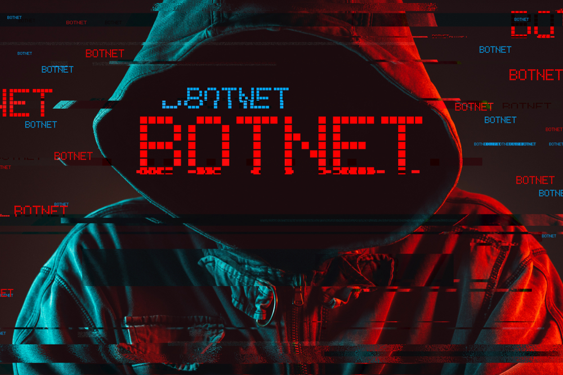

Slide 2

BOTNET ATTACK DETECTION ON IOT DEVICES
Aritra Mukherjee- CIS/17/04/No. 004 Shinjita Das- CIS/17/04/No. 016
Sujash Naskar- CIS/17/04/No. 024
Debasish Chatterjee- CIS/17/04/No. 010
Under the guidance of Prof. Gautam Mahapatra

Slide 3
What Does BotNet really mean?
A group of internet-connected devices controlled by a central system

Slide 4
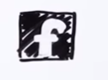




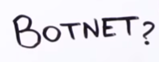


Slide 5
Task performed by BotNet:
DDoS
Malware
Service Disruption
Something “Bad”

Slide 6
What made it so EASY?

Slide 7

IoT – Internet of Things

Slide 8
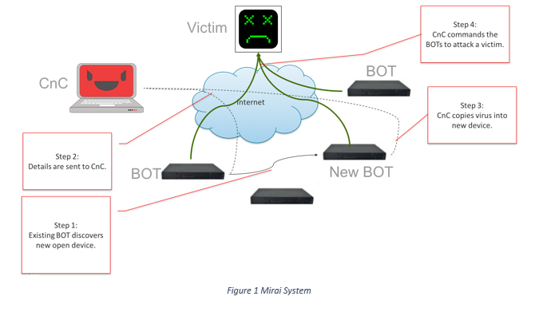
The BotNet Architecture:

Slide 9
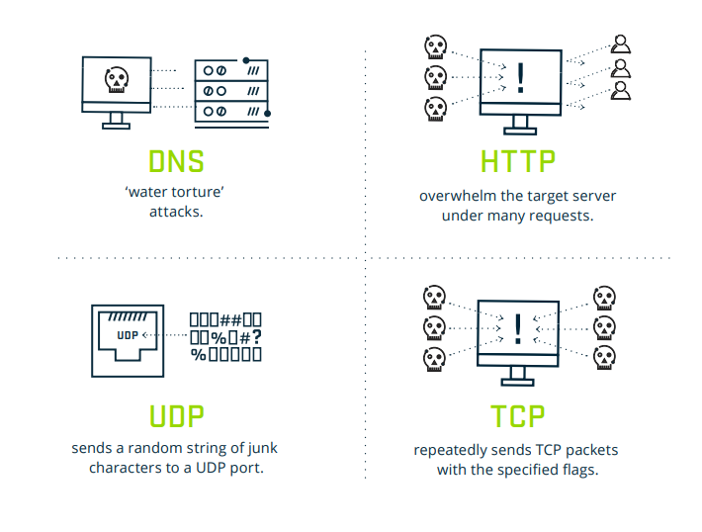
Common techniques used to perform BotNet attacks:

Slide 10
PRACTICAL EXAMPLE OF BOTNET ATTACK

Slide 11
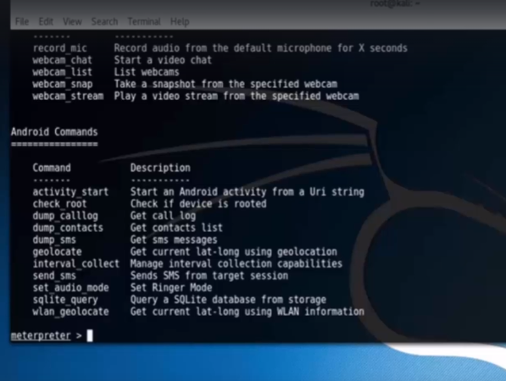
Attack on Android (Reverse TCP Attack) :

Slide 12
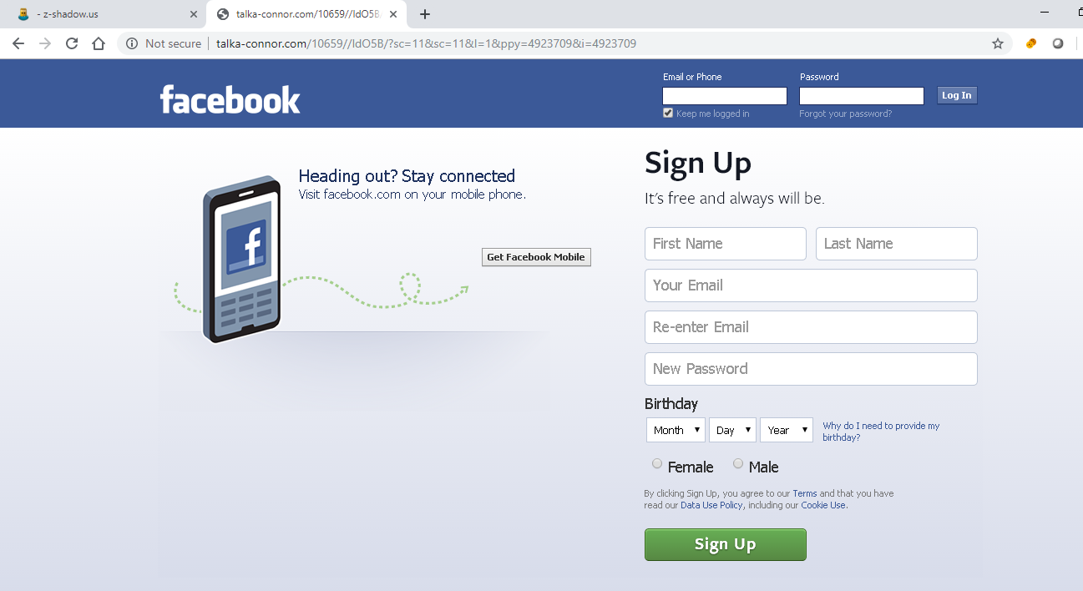
Site Cloning :

Slide 13
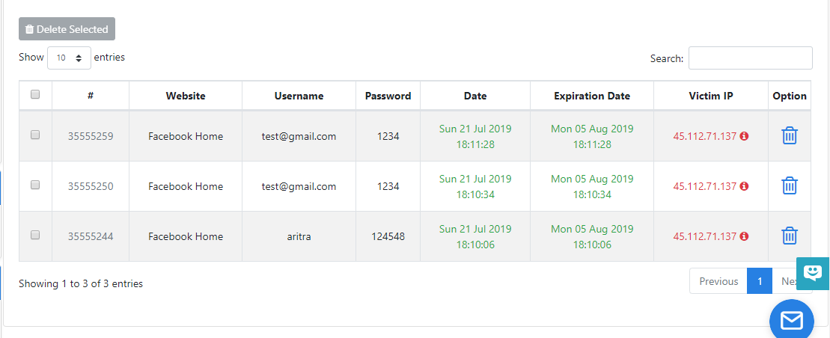
Phising Attack(Application of site cloning):

Slide 14
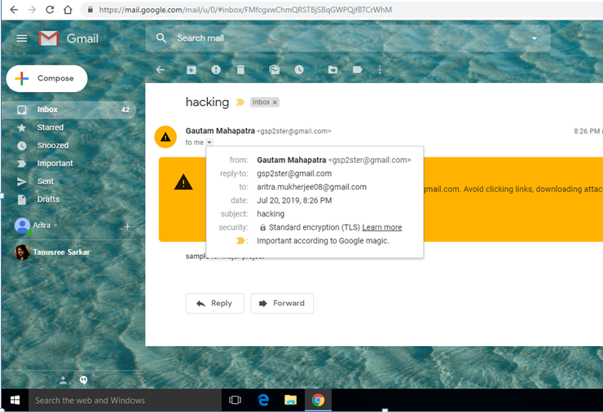
Fake mail sending:

Slide 15
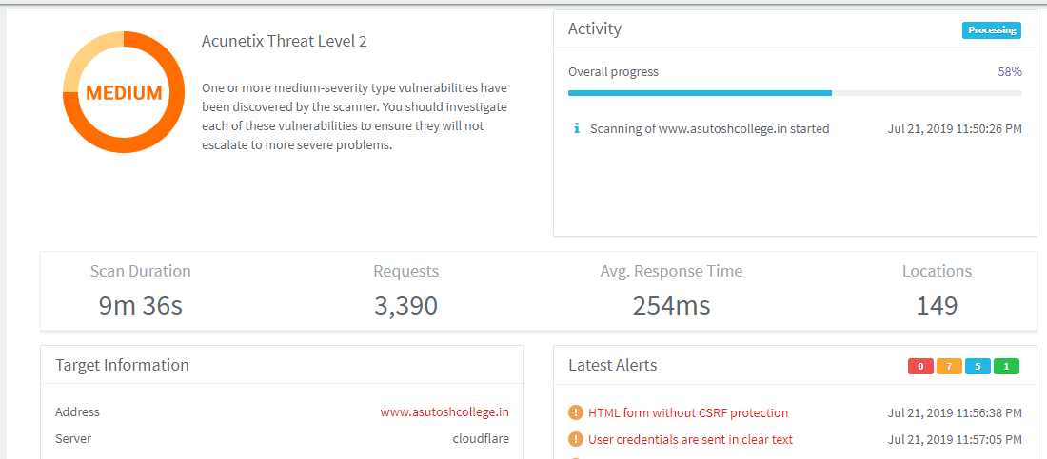
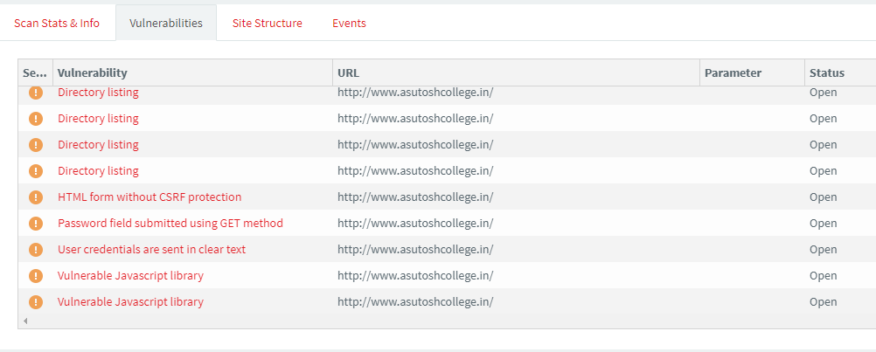
Finding vulnerabilities in a site to exploit:

Slide 16
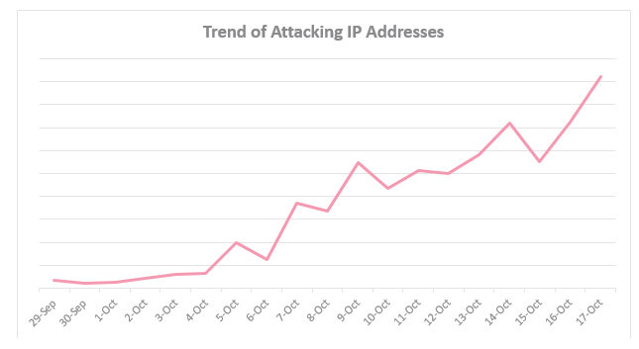
BotNet Attack Trend:

Slide 17

How much INSECURE our devices are?

Slide 18
How Botnets Can be detected ?

Slide 19
Most used BotNet detection Techniques:
IDSs
HoneyNets
signature-based
anomaly-based
Host based
Network based

Slide 20
Motivations:
Traditional detection approaches failed:
Signature Based approach
Problem Hard:
Lack of general definition of Botnet Behavior
Attackers have much freedom
Need a new approach:
Machine learning rescue

Slide 21
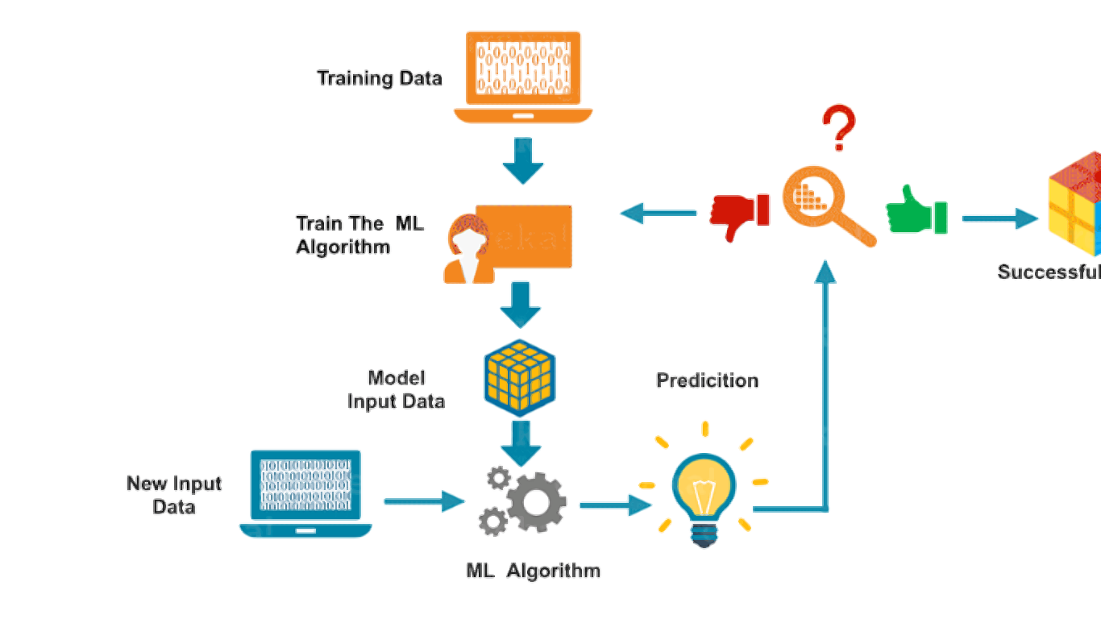
How Machine Learning works?

Slide 22
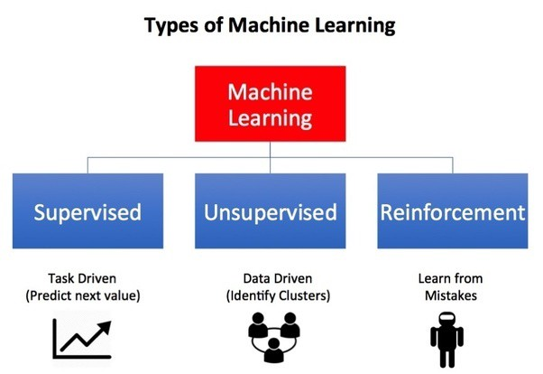
Types Of Machine Learning:
Supervised Learning – Train me!
Unsupervised Learning – I am self sufficient in Learning.

Slide 23
Some Machine Learning Algorithm used in Detection of BotNet :
C4.5
Random Forest
Support Vector Machine(SVM)
Artificial Neural Network(ANN)
K Nearest Neighbors

Slide 24
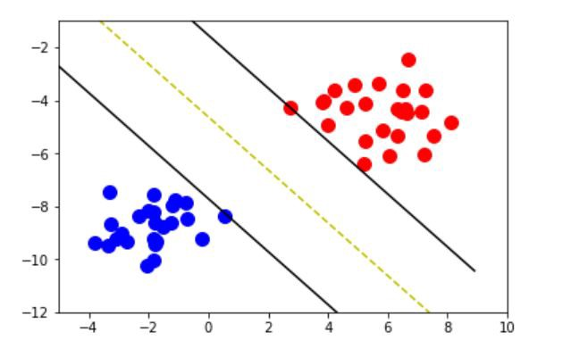
Support Vector Machine
A Support Vector Machine or SVM is a supervised machine learning algorithm that analyzes data for classification and regression.
Primarily a binary linear classifier as well as multiclass classifier.
Binary classifier

Slide 25
Classifier Margin
x
x
f
f
y^{est}
y^{est}
f(x,w,b) = sign(w x + b)
f(x,w,b) = sign(w x + b)
denotes class ‘p’
denotes class ‘q’
w x + b>0
Define the margin of a linear classifier as the width that the boundary could be increased by before hitting a datapoint.
Define the margin of a linear classifier as the width that the boundary could be increased by before hitting a datapoint.
w x + b=0
w x + b<0

Slide 26
Maximum Margin
x
f
y^{est}
f(x,w,b) = sign(w x + b)
denotes +1
denotes -1
Support Vectors are those datapoints that the margin pushes up against
This is the simplest kind of SVM (Called an LSVM)
Linear SVM

Slide 27
Dataset with noise
denotes p
denotes q
Hard Margin: So far we require all data points be classified correctly
- No training error
What if the training set is noisy?
OVERFITTING!

Slide 28
Soft Margin Classification
Slack variables ξi can be added to allow misclassification of difficult or noisy examples.
What should our quadratic on be?
Minimize
ε₁
ε₂
wx+b=1
ε₃
wx+b=0
wx+b=-1

Slide 29
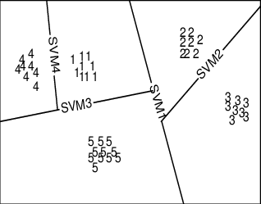
SVM as Multi-Class Classifier
It only considers two classes (primarily)
- One solution to multi-class classification
1) For m output classes generate m support vectors i.e.,
SVM 1 learns “Output==1” vs “Output != 1”
SVM 2 learns “Output==2” vs “Output != 2”
.
.
.
SVM m learns “Output==m” vs “Output != m”
2) To predict the output for a new input
Consider the closest into true class

Slide 30
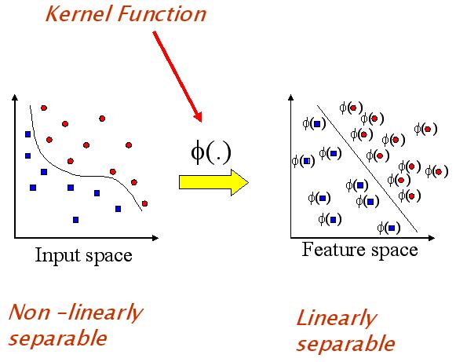

Kernel functions to transform linearly inseparable data into separable data
Fig-1
Fig-2

Slide 31
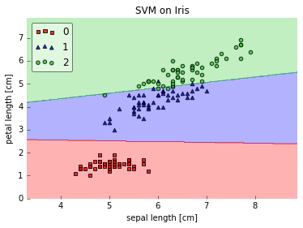
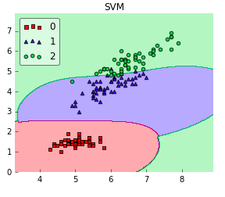
Kernels and why different kernels
Linear Kernel
RBF Kernel

Slide 32
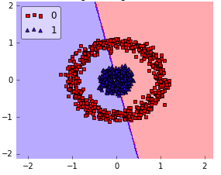
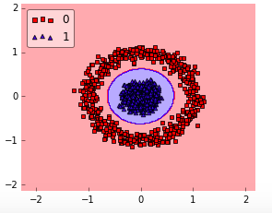
Kernels and why different kernels
Linear Kernel
RBF Kernel

Slide 33
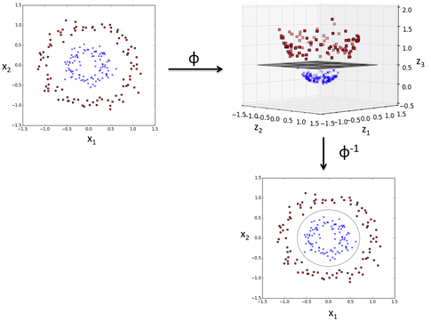

Slide 34
Advantages:
The kernel trick
High Dimensionality
Reduce overfitting

Slide 35
What is UCI dataset and
Why UCI dataset??

Slide 36
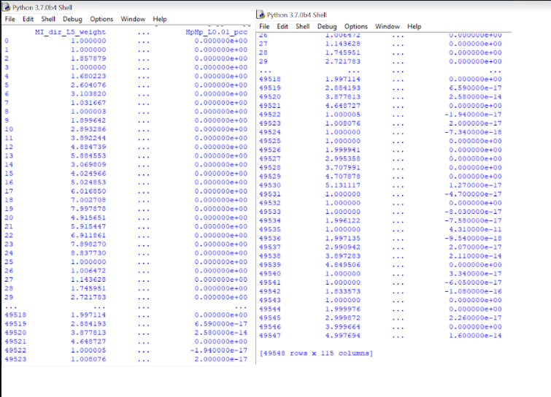
UCI Dataset :

Slide 37
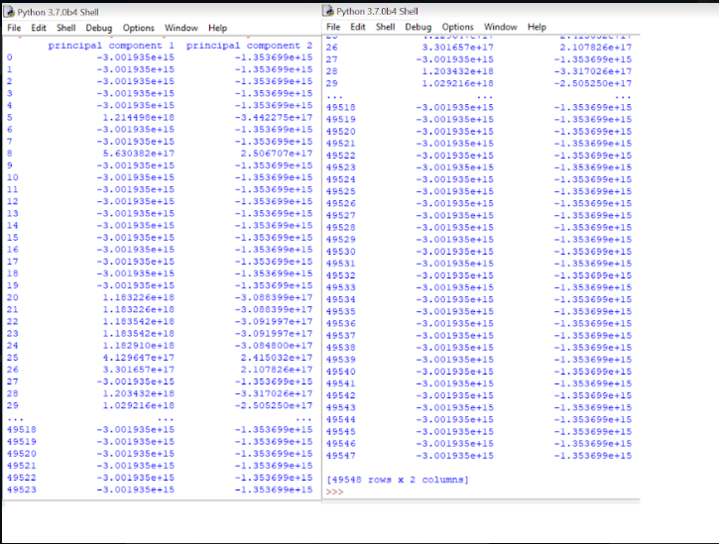
After PCA Transformation:

Slide 38
Implementation
SVM in python

Slide 39
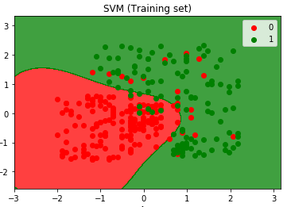
Predicted Output

Slide 40
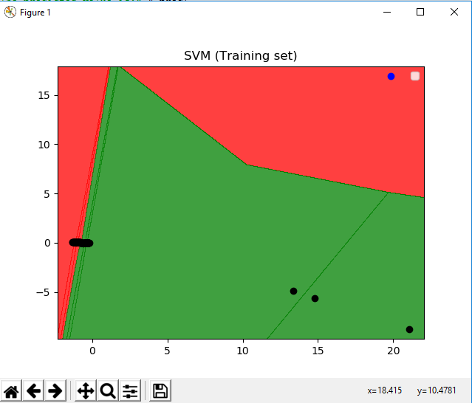
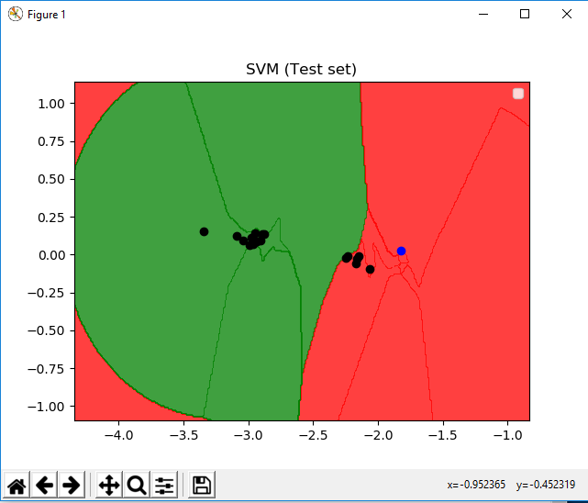
Experimental results

Slide 41
Discussions on Results:
Blue dots are expected in Red region, and Black dots are expected in Green region.
Any blue dot in Green region or black dot in Red region is Botnet
UCI Dataset contains 59717 rows and 115columns, but due to hardware limitation we can take maximum 500 rows.
Less data yields less accuracy.
PCA function has been used for visualization purpose.

Slide 42
Future scope:
We can use secondary memory based technique instead of ram based technique and Computationally Efficient methods.
Sampling techniques can be introduced to take more data.
Selective combination of ensemble members.
Heterogeneous ensemble learning.
Accuracy can be increased by taking more data.
If, somehow we can manage to detect the attack at the time of execution, then may be it can be prevented.

Slide 43
References:
Chityala, R. and Pudipeddi, S., 2014. Image processing and acquisition using Python. Chapman and Hall/CRC.
Jeong, O.R., Kim, C., Kim, W. and So, J., 2011. Botnets: threats and responses. International Journal of Web Information Systems, 7(1), pp.6-17.
Schaathun, H.G., 2012. Machine learning in image steganalysis. Wiley-IEEE Press.
Hoang, X. and Nguyen, Q., 2018. Botnet detection based on machine learning techniques using DNS query data. Future Internet, 10(5), p.43.
Karim, A., Salleh, R.B., Shiraz, M., Shah, S.A.A., Awan, I. and Anuar, N.B., 2014. Botnet detection techniques: review, future trends, and issues. Journal of Zhejiang University SCIENCE C, 15(11), pp.943-983
Miller, S. and Busby-Earle, C., 2016, December. The role of machine learning in botnet detection. In 2016 11th International Conference for Internet Technology and Secured Transactions (ICITST) (pp. 359-364). IEEE.
https://www.normshield.com/machine-learning-in-cyber-security-domain-9-botnet-detection/
https://www.kaggle.com/farhanmd29/svm-model-for-social-network-ads
https://en.wikipedia.org/wiki/Botnet
https://archive.ics.uci.edu/ml/datasets/detection_of_IoT_botnet_attacks_N_BaIoT ( dataset purpose)
https://data-flair.training/blogs/svm-kernel-functions/

Slide 44

Thank you !!

